Slide 1
The Four Required Labs
Part D of the Living Environment Regents Exam covers concepts discussed in the four New State required lab activities.
The four required labs are:
1. Relationships and Biodiversity
2. Making Connections
3. The Beaks of Finches
4. Diffusion through a Membrane

Slide 2
Relationships and Biodiversity
The theme of this activity is finding a plant compound known as Curol (which cures certain types of cancers) in a closely related non-endangered species to the endangered plant known as Botana curus .
The activity has the student look at structural and molecular relationships between Botana curus and three other closely related species (X, Y, and Z).

Slide 3
Relationships and Biodiversity
The following slides illustrate some typical questions you will find in Part D that will test your knowledge of the Relationships and Biodiversity activity.

Slide 4
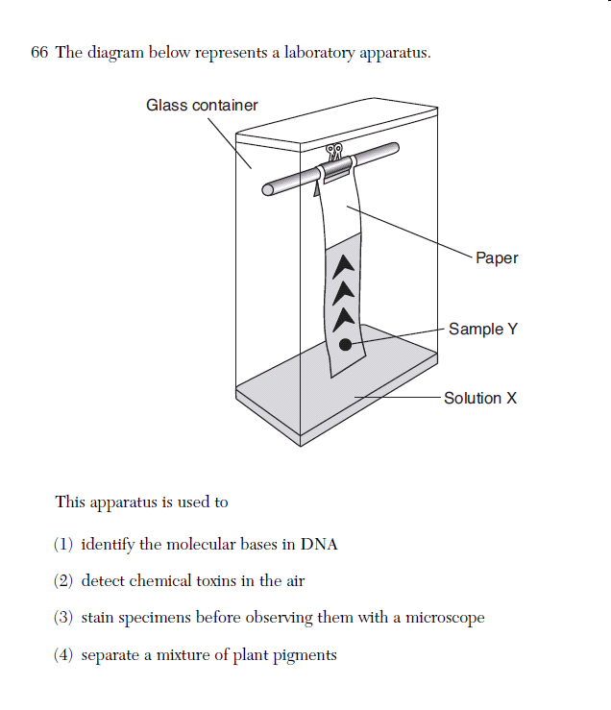
This question covers chromatography.
Chromatography is a technique that separates plant pigments.
We used chromatography to separate the pigments found in the leaves of some common plants.

Slide 5
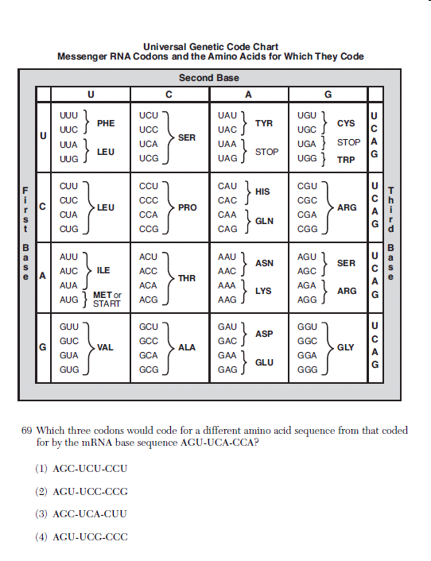
This question covers the molecular relationship between species.
Remember that DNA yields mRNA which is used to synthesize proteins.
If a two species have similar DNA they should have similar proteins.

Slide 6
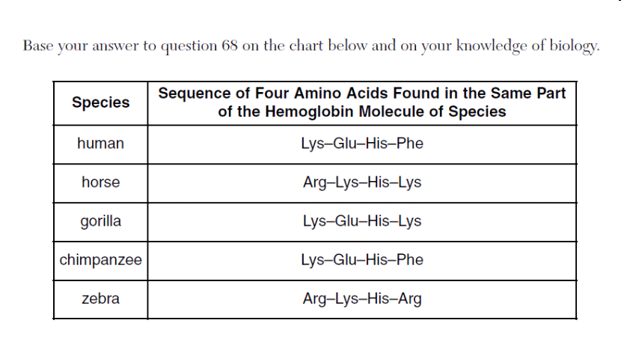
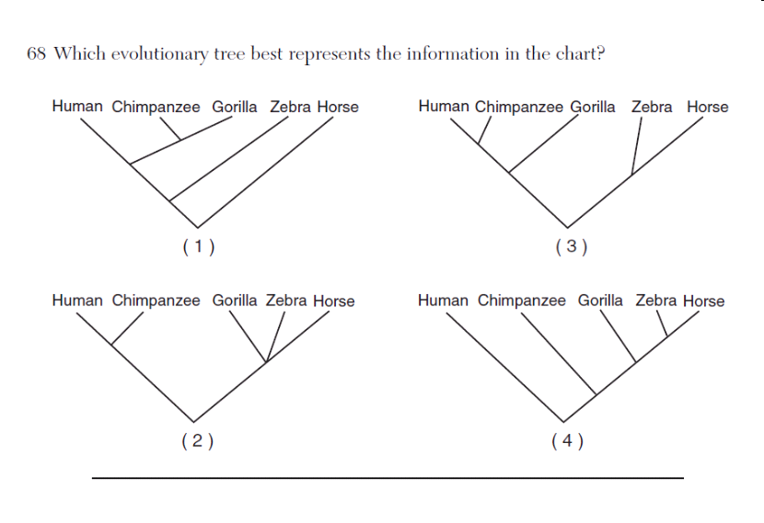
Question 68 uses the amino acid sequence that results in the production of a protein to show evolutionary relationships. The sequence is the same in humans and chimpanzees.

Slide 7
Chromatography

Slide 8
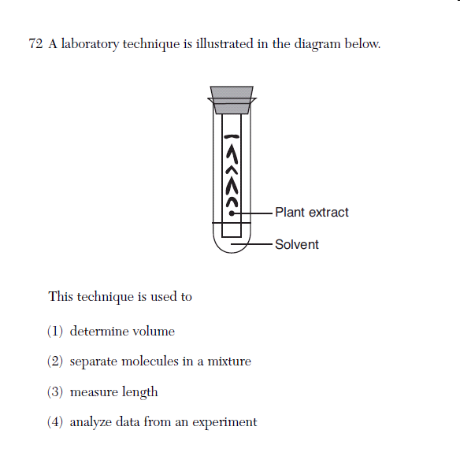
Here is another chromatography question.

Slide 9
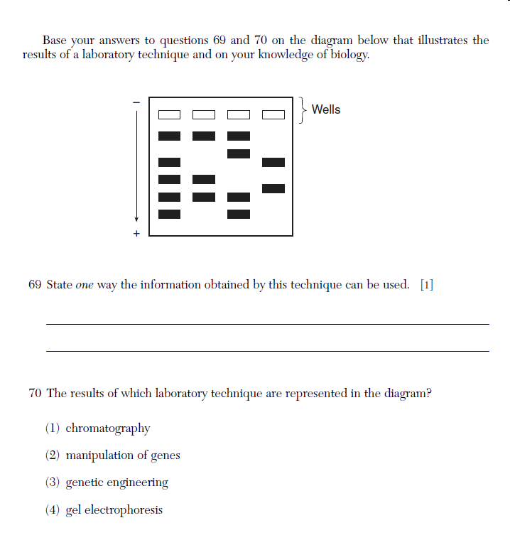
Questions 69 & 70 cover DNA electrophoresis. Restriction enzymes cut DNA into fragments. These fragments are placed in the wells of a electrophoresis gel. Electric current is then passed through the gel separating the fragments by size. The smaller fragments move farther away from the wells while the larger fragments remain close to the wells. If the DNA of two species is similar they will produce similar fragments.

Slide 10
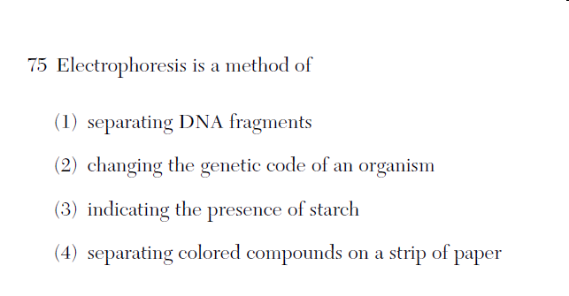

Slide 11
Question 75 is straight forward. Questions like this one often add a statement about chromatography. The correct answer is # 1 while statement # 4 would apply to chromatography.

Slide 12
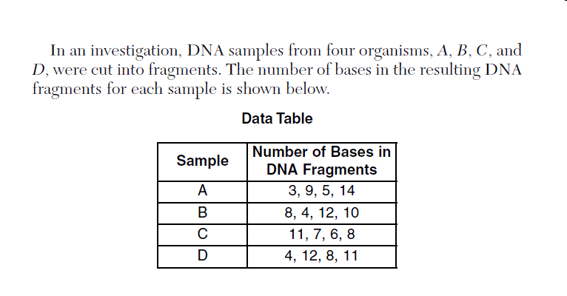

Slide 13
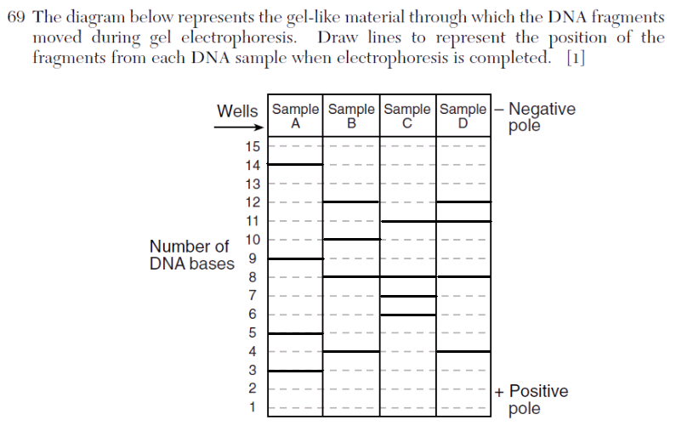
Here is the electrophoresis gel that results when you add the bands that were stated in the chart.

Slide 14
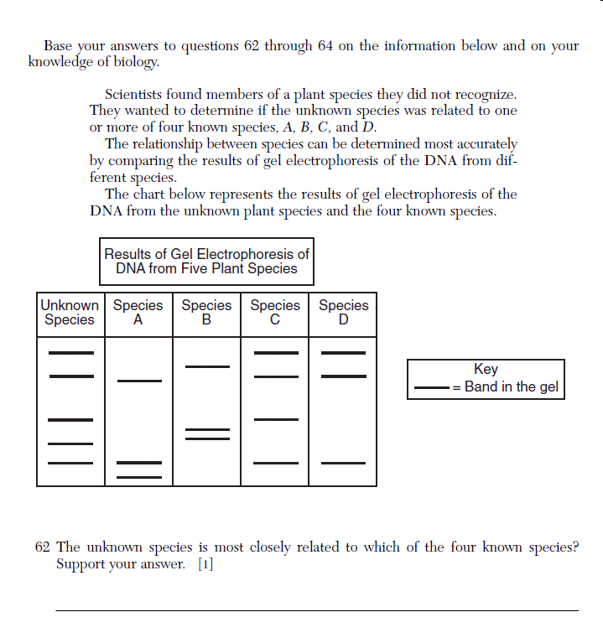
Here is one last series of questions that deals with the Relationship & Biodiversity Activity.

Slide 15
Here is one last series of questions that deals with the Relationship & Biodiversity Activity.
In this case Species C is most closely related to the unknown species (species C has four out the five bands in common)

Slide 17
Making Connections
The Making Connections activity covers human physiology.
In this activity you squeeze a clothes pin and record your results in a data table.
You then constructed a histogram from the record data.
In part 2 of this activity, you were to design an experiment after the development of a hypothesis.
Remember a hypothesis is never stated as a question. A hypothesis is usually an “If then” statement.

Slide 18
Making Connections
The next series of slides are some typical questions that test your knowledge of the Making Connections activity.

Slide 19
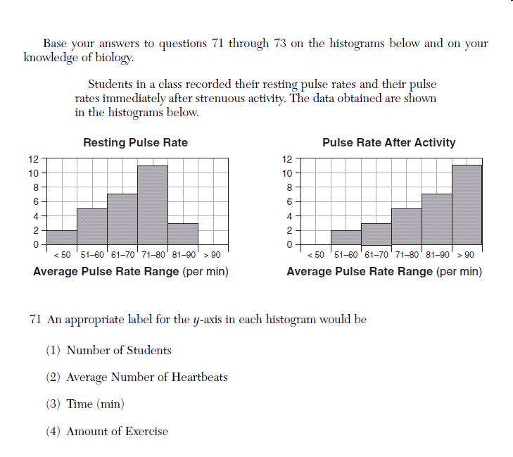

Slide 20
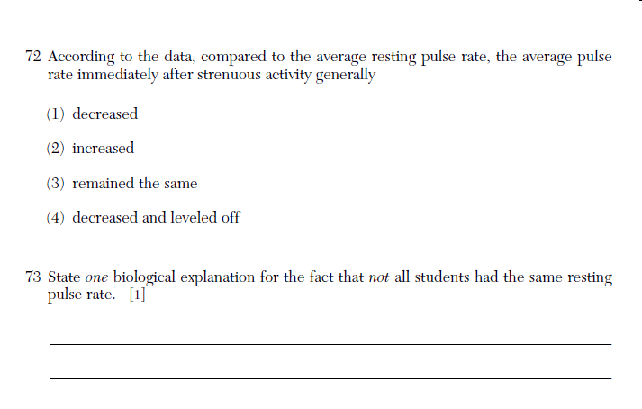

Slide 21
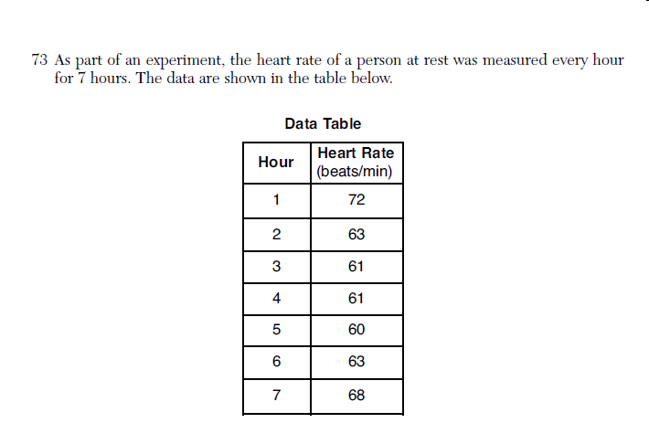
Question 73 gives you a data table. From this information which of the four graphs shown in next slide best represents that data? Note that the independent & dependent variables are not clearly stated.

Slide 22
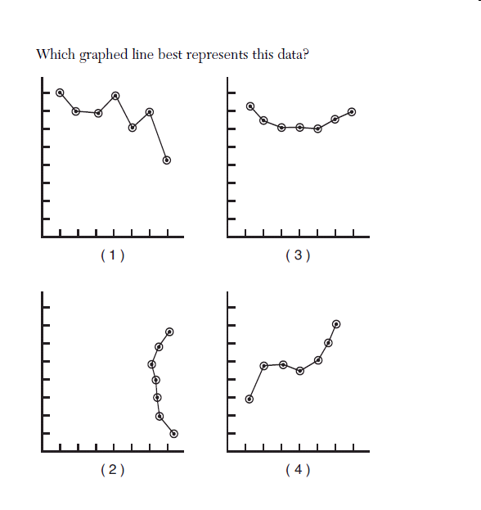

Slide 23
Graph 3 is the best answer
Y axis is Heart beat (beats/minute)
X axis is Time in hours

Slide 24
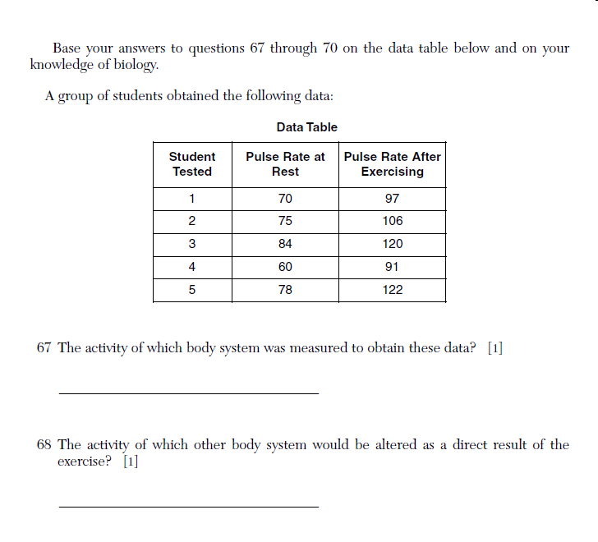
Questions 67 through 70 again cover the Making Connections activity

Slide 25
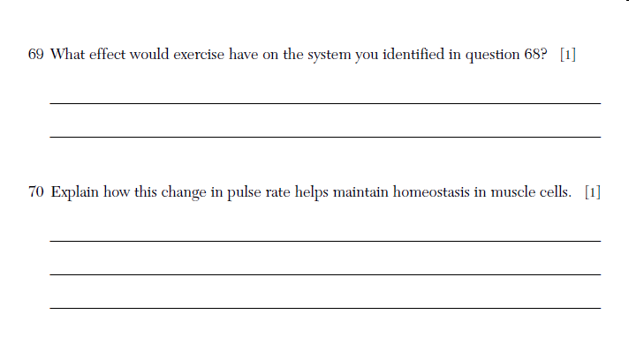

Slide 26
When answering these questions you should remember that homeostasis is the condition of internal stability & that body systems coordinate their activities to maintain homeostasis. In this case the Respiratory & Circulatory systems are working together in the maintenance of homeostasis.

Slide 27
The Beaks of Finches
In this activity you will investigate Natural Selection.
Remember that species compete for limited environmental resources & the most fit will survive while those that are less fit will be eliminated.
The activity also covers species adaptation to a changing environment.

Slide 28
The Beaks of Finches
The next series of slides will illustrate some typical questions found on the regents exam that covers this activity.

Slide 29
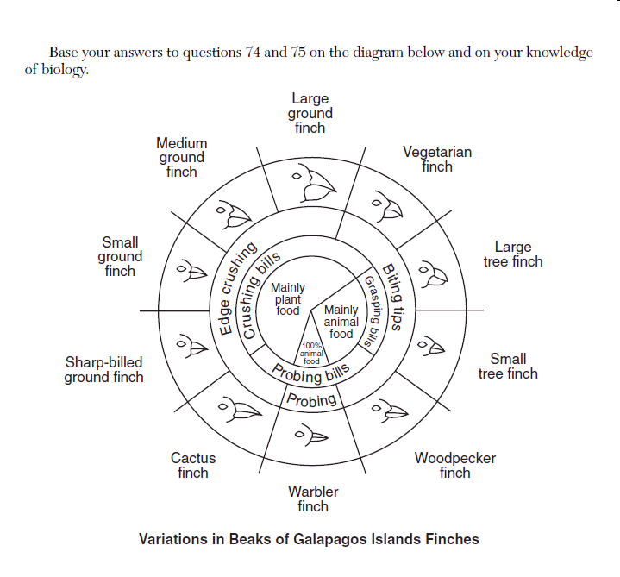
This is the diagram that shows the variations in the Galapagos Islands finches.
The questions test your ability to read & interpret the diagram.

Slide 30
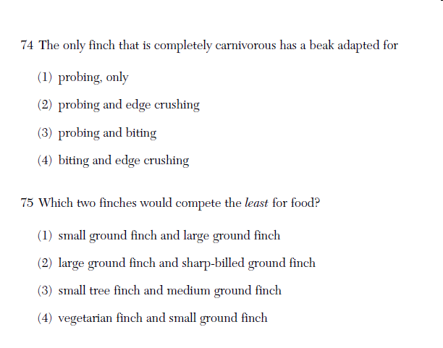

Slide 31
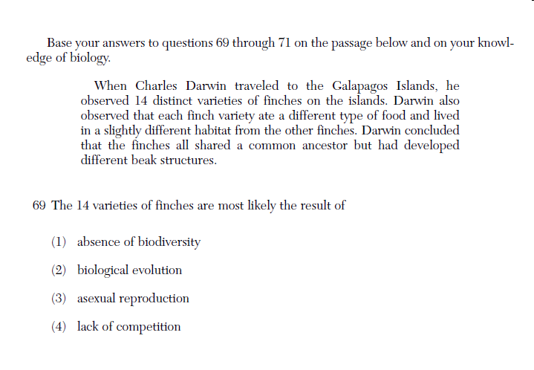

Slide 32
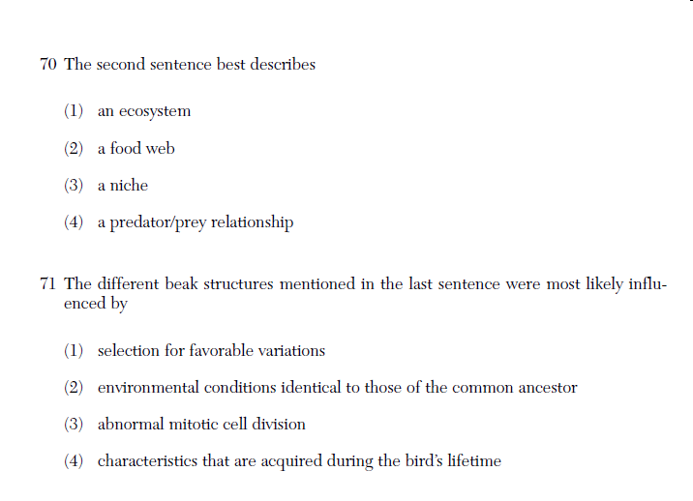

Slide 33
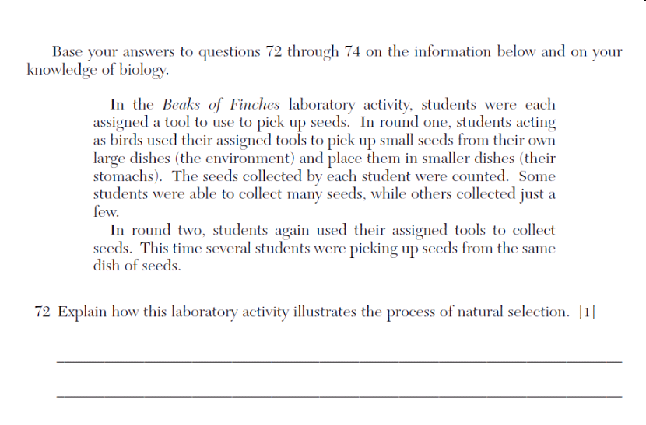

Slide 34
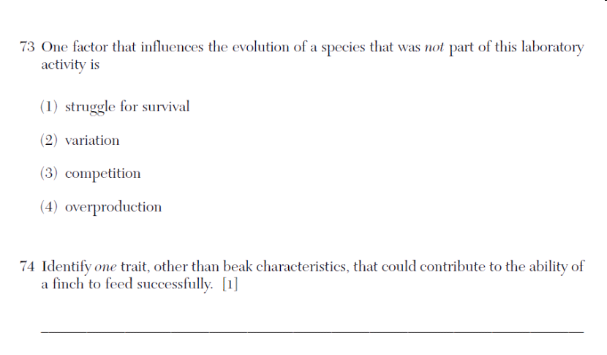

Slide 35
Diffusion through a Membrane
The diffusion through a Membrane Activity covers the movement of a substance from an area of high concentration to an area of low concentration.
Remember Osmosis is the diffusion of water.
The next series of slides will show some typical questions that cover this activity.

Slide 37
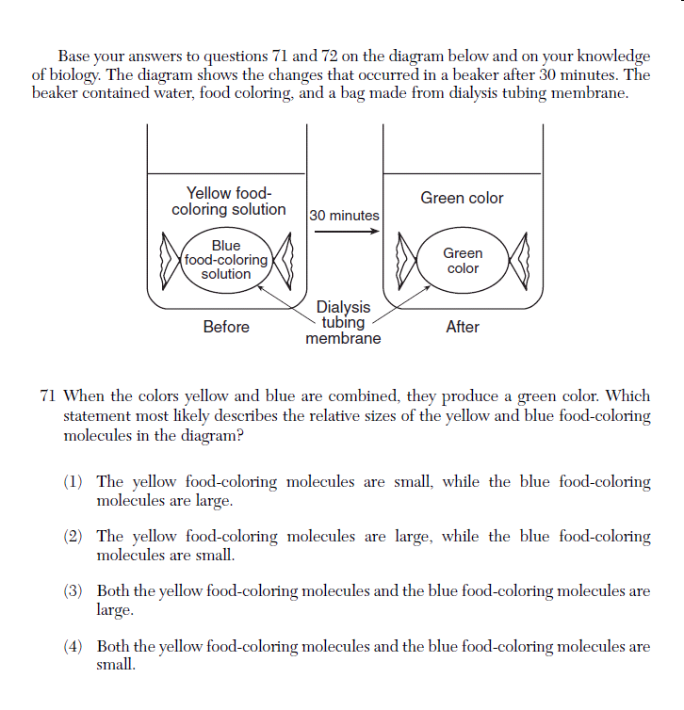

Slide 38
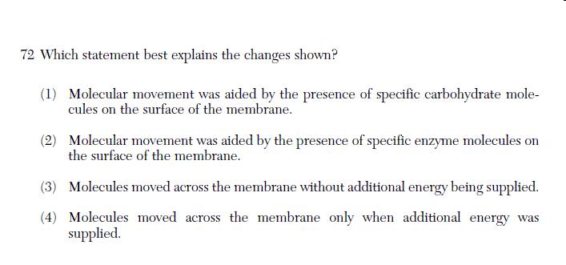

Slide 39
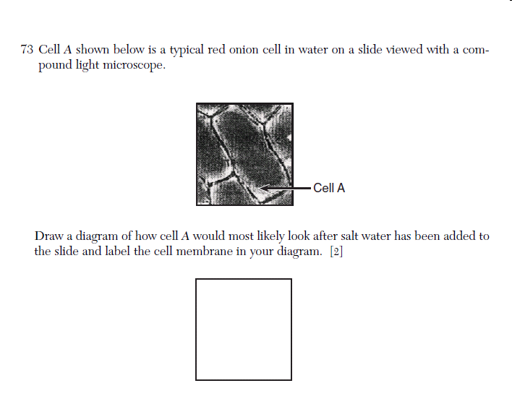

Slide 40
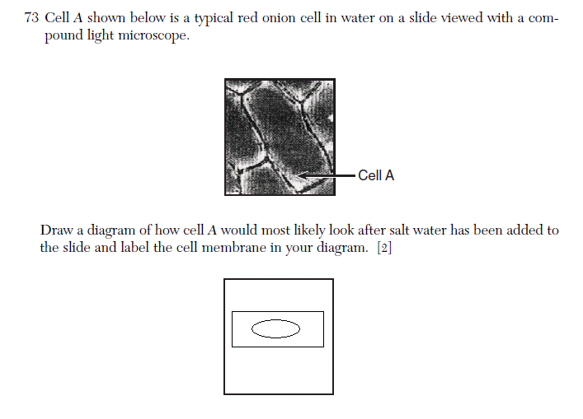
Cell membrane
The onion cell has been placed in a hypertonic solution & will shrink due to a loss of water.

Slide 41
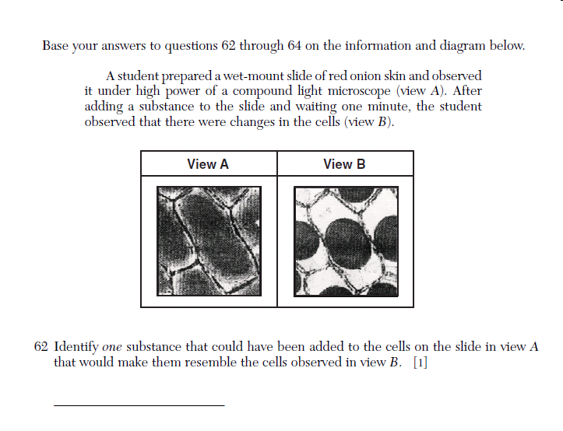

Slide 42
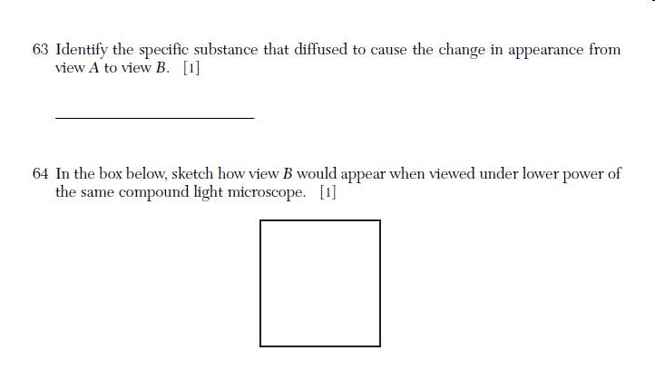

Slide 44
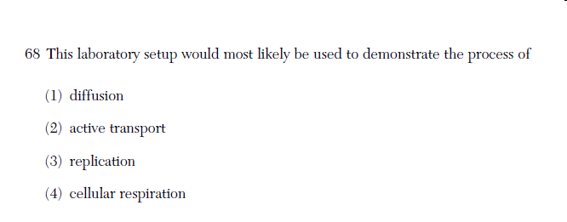

Slide 45
Remember Active Transport is the movement of material from an area of low concentration to an area of high concentration with the expenditure of energy (ATP).

Slide 46
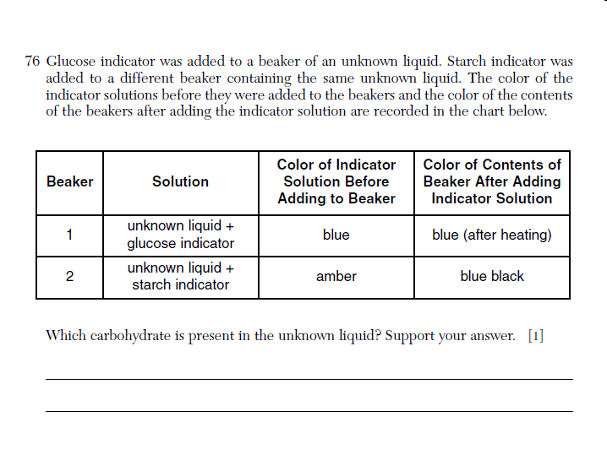

Slide 47
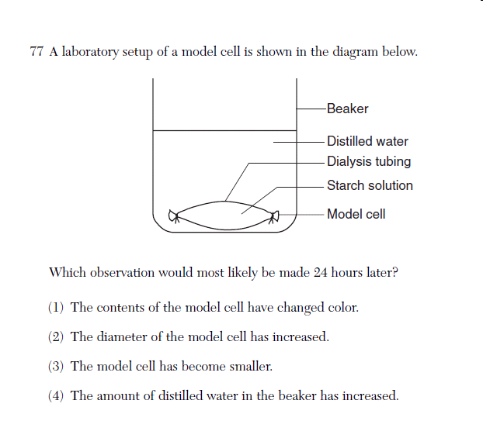

Slide 48
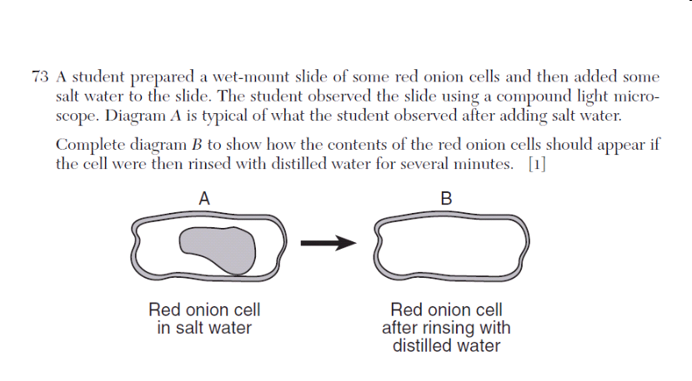

Slide 49
In this situation, the onion cell has been placed in a hypotonic solution (LOW SOLUTE/HIGH SOLVENT) the cell will gain water & the cell membrane will swell to the point of pressing against the cell wall.

Slide 50
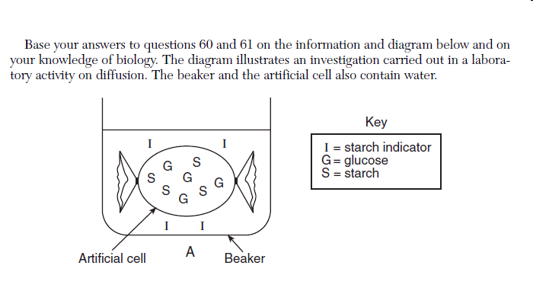
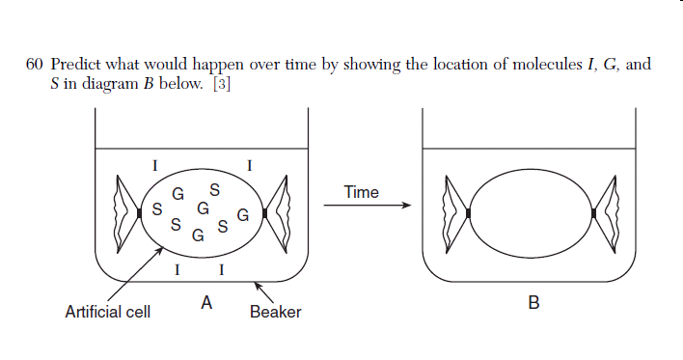

Slide 51
Question 60, I → iodine will flow into the artificial cell & react with the starch solution causing a color change (black/blue). G → glucose will diffuse out of the artificial cell. Remember the solutes I & G will reach equilibrium, while starch will remain in the artificial cell.

Slide 53
